Slide 1
Penetration Testing on Web Server
Target: testphp.vulnweb.com
Prepared by: Rohinish Sharma
Pankaj Singh

Slide 2
1.Project Objective:
To simulate a real-world attack on a test web server by:
Performing footprinting
Scanning for vulnerabilities
Attempting exploitation (ethical test only)
Collecting evidence of weaknesses
Recommending security hardening techniques

Slide 3
2. Footprinting
Information collected:
- IP address of website
- Server location and OS
- Web server tech and version
- Directory listing
- Whois, DNS info
- Employee emails and LinkedIn profiles.

Slide 4
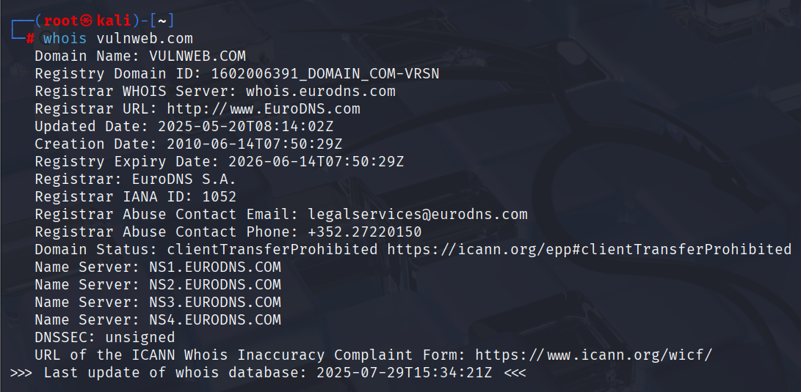
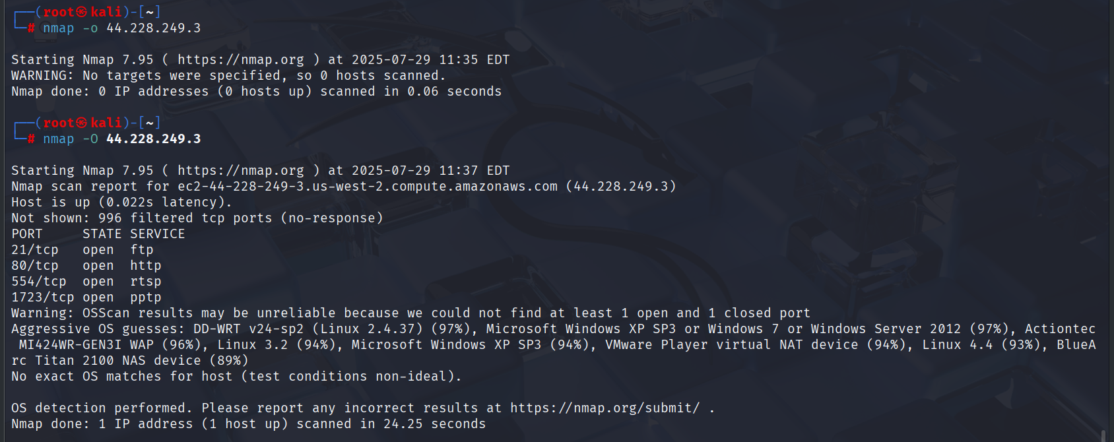

Slide 5
3. Vulnerability Scanning
Tools used: Nikto, Nmap, sqlmap.
Findings: Web vulnerabilities like outdated software, exposed directories, potential SQL injection points.

Slide 6
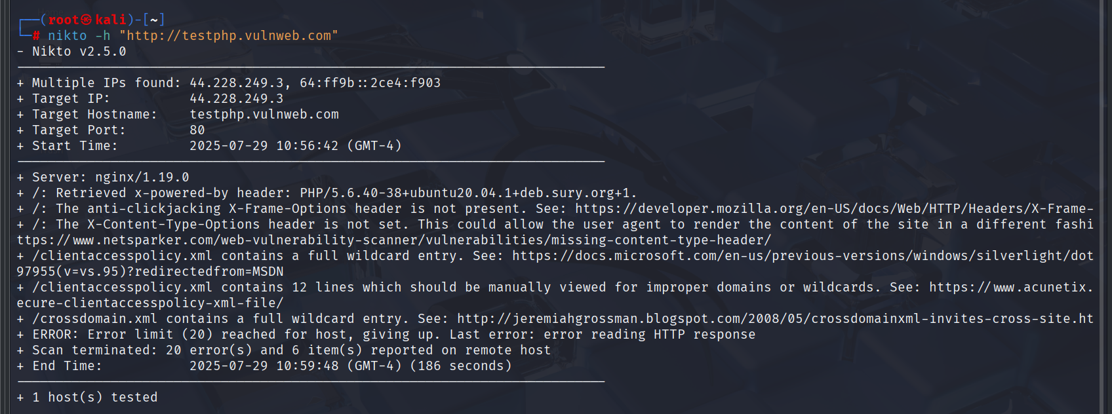
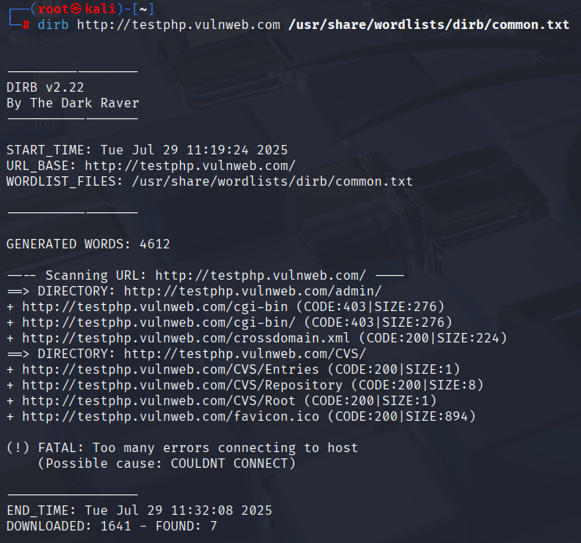

Slide 7
4. Exploitation Attempts
Exploits tested:
- SQL Injection
- Directory traversal
- Brute-forcing login forms
Tools: sqlmap, Hydra, Burp Suite.

Slide 8
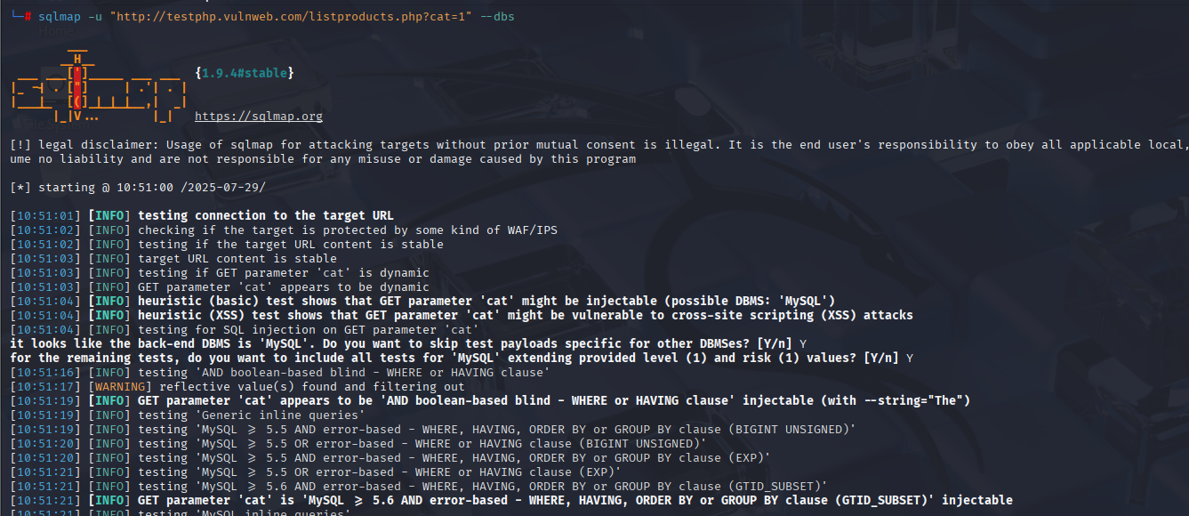
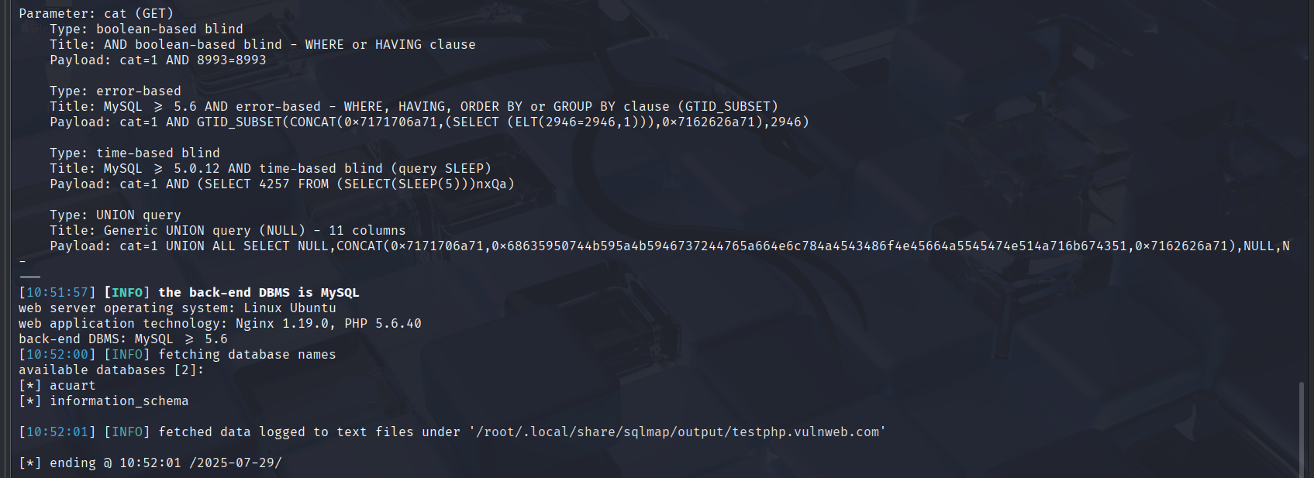

Slide 9
5. Database Access Check
Attempted database access using SQLi techniques.
If successful, tables and contents were extracted using sqlmap.

Slide 10
6. Conclusion
-Exposed directories and files (e.g., robots.txt, admin/, phpinfo.php)
-Outdated web technologies (e.g., Apache version, PHP version)
-Input fields vulnerable to SQL Injection and XSS
-Lack of proper access controls and input validation

Slide 11
7. Tools Used and Their Purpose
List of tools:
- Nmap: Network scanning
- Nikto: Web server scanning
- sqlmap: Database testing
- theHarvester: Email discovery
- Burp Suite: Manual vulnerability testing.

Slide 12
8. References
Useful references:
- SQLMap documentation
- MITRE CVE Database
- HackerOne reports
- Official tool documentation.

